Slide 1
W266: Natural Language Processing
Introductions

Slide 2
Welcome!
Week 1: NLP & NN Basics
Week 2: NN Basics & Training
Week 3: Classification & Sentiment
Week 4: Part of Speech + Parsing
Week 5: Convolutional Neural Networks (CNNs)
Week 6 - 7: Language Models
Week 8: Machine Translation
Week 9: Advanced MT: Transformers & Transfer Learning
Week 10: Summarization
Week 11: Entities/Information Extraction
Week 12: Document Classification
Week 13: Information Retrieval

Slide 3
Today’s Agenda
Introductions & course overview (~15 minutes)
Why is language interesting? (~15 minutes)
NLP tasks and structures (~10 minutes)
Parts of a neural net: affine and nonlinearities (~40 minutes)
Motivating a loss function (~10 minutes)

Slide 4
Course Overview
We’ll aim to cover most foundational NLP topics and common tasks.
Develop intuition for computational linguistics
Emphasis on practical understanding
In particular, we’ll highlight a few key aspects of that week’s async in live session. The most important material will appear in live sessions and the assignments.

Slide 5
TL;DR:
(You’ll need to read the syllabus in detail to answer A0 questions.)
Grading: Assignments + Project
Course is curved; curve not released, about ¼ each of A, A-, B+, B
Project: Start thinking about the project soon (see Project GitHub page)
Weekly Assignments: … approx. every week? Some bigger than others!
Extensions on Assignments: Use late days

Slide 6

Questions?
Notes:
A0 contains

Slide 7
Resources
Eight sections, but we’ll share resources.
Piazza for Q&A: https://piazza.com/berkeley/spring2021/datasciw266
Keep questions on Piazza (you can mark “Anonymous”)
Keep questions public unless they include assignment solutions
Oh noes, the sky is falling! Email instructor list and cc student support
Syllabus and materials: https://github.com/datasci-w266/2021-spring-main

Slide 8
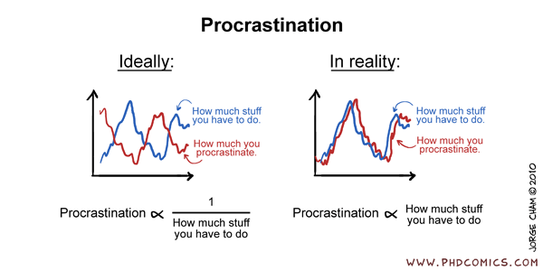
Advice...
START EARLY!
These assignments are TRICKY!

Slide 9
Assignments: Start early… Start Now
A0 Course Set-up: already available, due end of this week
A1 Background and deep learning:
Release Saturday evening (1/9)
Due Sunday (1/17) 11:59pm PST

Slide 10
Language

Slide 11


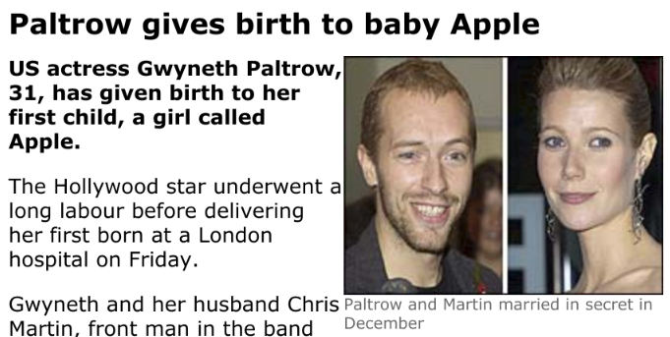
Why is language understanding hard?

Slide 12
Reading Discussion
-> AI’s Language Problem <-
Notes:
discussion of grounding problem, ambiguity in language

Slide 13
NLP Tasks and Structures

Slide 14
How do we think about NLP?
NLP can be characterized as:
A set of tasks involving language
Tasks are cast as a particular type of problem structure
A model architecture is selected to learn to make inferences about the task
The parameters of the model are trained to best fit the training data
This class will teach you to address common NLP tasks by architecting, coding, and training appropriate model architectures (usually neural networks)

Slide 15
Some NLP Tasks
Question Answering
Machine translation
Summarization
Natural Language Inference (NLI)
Sentiment
Semantic Role Labeling
Relation Extraction
Goal Directed Dialog
Semantic Parsing
Commonsense Reasoning
Language Modeling
Entity Recognition
Word Sense Disambiguation
Part of speech tagging
Phrase extraction
Fact extraction

Slide 16
Common NLP Problem Structures
Most of these problems are (usually multi-class) classification problems! Like:
Language Modeling:
“Given what has been said so far, what is likely as the next word?”
Predict probability distribution over all words in vocab
Machine Translation:
“Given the source language and what was translated so far, what is the most likely next target language word?”
Predict probability distribution over all words in vocab
Text Classification/Sentiment Analysis:
“Given my text what is the most likely class label”
Predict probability distribution over all sentiment classes
Named Entity Recognition:
“Given my text, what is the most likely label for each word (token)?”
Predict probability distribution over all labels (for each token)

Slide 17
Other General NLP Problem Structures
Span detection - identify beginning and end of a span
Text pair matching - are these two words/sentences semantically similar
Text Meaning - represent words in a semantic space
Dialog (directed conversation) - input a statement and emit an appropriate response
Sentence Parsing - input a sequence of words and generate a parse tree
...

Slide 18
Some Network and Model Architectures
NLP uses a wide variety of network architectures to perform tasks:
Multi-layered Perceptron (MLP)
Deep Averaging Network (DAN)
Convolutional Neural Net (CNN)
Recurrent Neural Nets (RNN, GRU, LSTM)
Transformers
Sequence to Sequence (Encoder Decoder)
Generative Adversarial Network (GAN)
Siamese networks
….

Slide 19
Tasks -> problem structures -> Architectures*
Task | Standard Problem Structure | Architectures
Question Answering | Span Detection, Answer Retrieval | Transformers, Sequence labeling
Machine translation | Sequence to sequence | Transformers, Encoder - decoder
Abstractive Summarization | Sequence to sequence | Transformers, Encoder - decoder
Natural Language Inference (NLI) | Text Pair Classification | Various
Sentiment | Classification | Transformers, CNN
Semantic Role Labeling (SRL) | Sequence Labeling | Transformers, LSTM
Relation Extraction | Classification | various
Goal Directed Dialog | Sequence to sequence | Encoder - decoder
*No claim of completeness is made

Slide 20
A Canonical Approach
Probability distribution of predictions
Understand problem structure and define exact task
Decide on the model
Identify proper text representation
Words as strings
Words as one hot vectors
Words as dense low dimension vectors
Think about how to best deal with sequential nature of text
Define architecture and layers etc.
Ensure model output models the task (usually some probability distribution)
Crank the ML machine...
positive neutral negative
Model
(usually some NN architecture)
“I really enjoyed this movie!”

Slide 21
In this class we will...
Learn about network architectures, and
Learn about NLP tasks and their problem structures, and
You will do a project that requires you to address an NLP task (and associated data set) with a particular network architecture and a specific problem structure

Slide 22
Resources for NLP Tasks
NLP Progress - list of NLP tasks and state of the art (SOTA) metrics
NLP Decathlon - ten standard tasks described and recast as Q & A
Glue - a set of standard tasks with a common scoring framework
Super Glue - additional tasks that are “harder”

Slide 23
Machine Learning and Simple Neural Nets

Slide 24
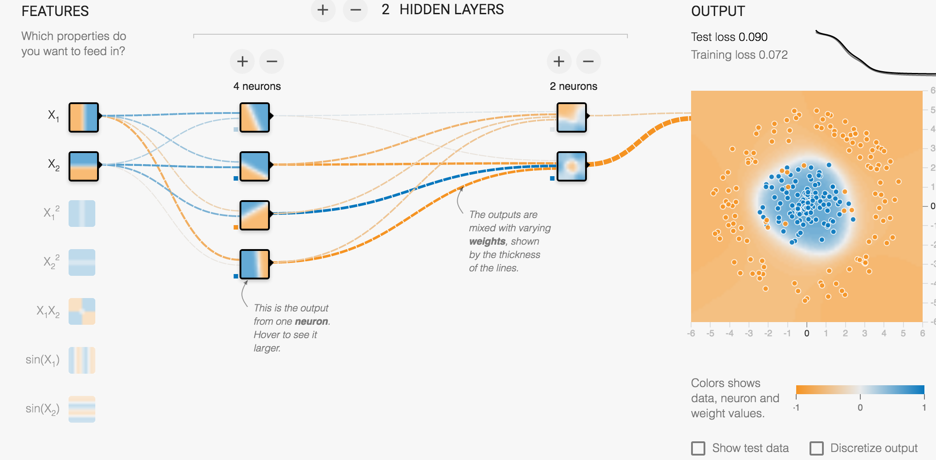
TensorFlow playground: http://playground.tensorflow.org/
Notes:
Also see https://colah.github.io/posts/2014-03-NN-Manifolds-Topology/ for more on how NN’s stretch and squeeze space to perform non-linear classification.

Slide 25
Mathematical View of a fully connected neural network

Slide 26
Networks and Matrices
H
X
H
O
H
One Neuron (Unit)
H
O
X
H
x₁
(w₁*x₁) + (w₂*x₂)
relu(z)
b
x₂
=
z
Notes:
Pink = input (x)
w = weighted sum of inputs
b = bias term
z = logit

Slide 27
Networks and Matrices
H
X
H
O
H
H
O
X
H
W0
W1
W2
relu(z0)
relu(z1)
softmax(z2)
x
x
x
p
+
=
+
z0
=
=
+
z1
z2
b0
b2
b1
What are the dimensions of W, b, and z in each layer?
Notes:
Pink = input
H1 = blue
H2 = yellow
Output = green
X0*W0 + b0 (1*3)) = Z0 (1024 * 3)
np.dot(X0, W0) + b0 = Z0

Slide 28
Networks and Matrices
H
X
H
O
T_i W_(ia) = S_a
4-d x (4x17) -> 17-d
H
H
O
X
H
W
W
W
relu(z)
relu(z)
softmax(z)
x
x
x
P
+
=
+
=
z
=
=
z
+
z
z
b
b
b
b
Notes:
Pink = input
H1 = blue
H2 = yellow
Output = green

Slide 29
Networks and Matrices
H
X
H
O
H
H
O
X
H
W
W
W
relu(z)
relu(z)
softmax(z)
x
x
x
x
P
+
=
+
=
=
=
z
=
z
+
z
z
z
b
b
b
b
Notes:
Pink = input
H1 = blue
H2 = yellow
Output = green

Slide 30
Networks and Matrices
H
X
H
O
H
H
O
X
H
W
W
W
relu(z)
relu(z)
softmax(z)
x
x
x
P
+
=
+
z
=
=
+
z
z
b
b
b
Notes:
Pink = input
H1 = blue
H2 = yellow
Output = green

Slide 31
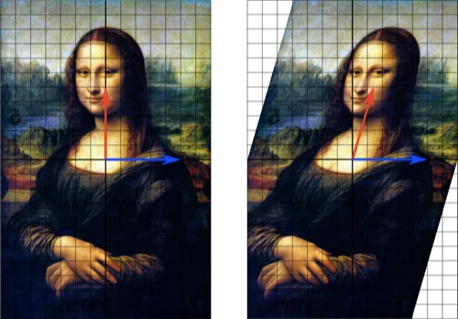
Intuition for Matrix Multiplication

Slide 32
Another (Identical) View of a Neural Network

Slide 33
Supervised Learning
x
f(x)
y’
y
Training Data
Model
Prediction

Slide 34
Supervised Learning
x = (x1, x2)
f(x)
y’
y = {“blue”, “orange”}
Training Data
Model
Prediction
e.g. logistic regression: y’ = σ(x₁ w₁ + x₂ w₂ + b)

Slide 35
z
x
xW + b
σ(z)
y’
y
Training Data
Model
Prediction
Logistic Regression

Slide 36
z
x
xW + b
σ(z)
y’
y
Training Data
Model
Prediction
Affine Layer
Non-linearity
Logistic Regression

Slide 37
z
x
xW + b
σ(z)
y’
y
z =
x
W
+
b
Dimensions?
Notes:
(n_x, n_z) n_z = n_y = number of labels if its multi-class (1 if it’s binary)

Slide 38
z
x
xW + b
σ(z)
y’
y
x
W
z =
+
b
Dimensions?
Notes:
x - (1, 2)
W - (2, 1)
b - (1, 1)
z - (1, 1)
y’ - (1, 1)
y - (1, 1)

Slide 39
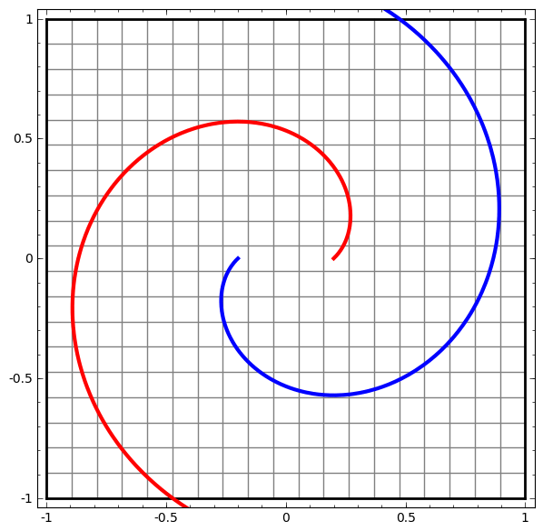
Fully-connected “Affine” Layer
h = f(x W + b)
Affine layer:
Matrix multiply W (rotate & scale)
Bias term b (translate in space)
Then:
Nonlinearity f (squish like dough)
Nonlinearity
Affine
From “Neural Networks, Manifolds, and Topology” (Chris Olah, 2014)
Notes:
One fully connected layer using a sigmoid is logistic regression!

Slide 40
Motivation for a Loss Function (and Relationship with Information Theory)

Slide 41
Classification: Loss Function Context
The model output is a probability distribution q(Θ) over a set of labels. (Θ represents all trainable parameters in your network model)
There is a correct label or a true probability distribution p
How do I teach my model to make predictions as close to true as possible?
The Loss Function: function that allows me to modify network parameters in order to minimize the difference between predicted and true during learning,

Slide 42
Log-Likelihood of Training Data
Simple example: imagine a multi-class classification problem with n classes...
The model believes the probability of each class I is q_{i}
You now do one ‘draw’, and it is class J. What ‘likelihood’ would you ascribe for that to happen?

Slide 43
Log-Likelihood of Training Data
Simple example: imagine a multi-class classification problem with n classes...
The model believes the probability of each class I is q_{i}
You now do one ‘draw’, and it is class J. What ‘likelihood’ would you ascribe for that to happen? L = q_{j}
You now do multiple (independent) ‘draws’, and, say, it is <J,J,K,J,I>. What ‘likelihood’ would you ascribe for that to happen? L = q_{j} q_{j} q_{k} q_{j} q_{i} = q_{j}³ q_{k}¹ q_{i}¹

Slide 44
Log-Likelihood of Training Data
If you had assumed q_{j} = 0.1, q_{k} = 0.4, q_{i} = 0.5, would you be surprised?
(L = q_{j} q_{j} q_{k} q_{j} q_{i} = q_{j}³ q_{k}¹ q_{i}¹ ) Probably…
Why?

Slide 45
Log-Likelihood of Training Data
If you had assumed q_{j} = 0.1, q_{k} = 0.4, q_{i} = 0.5, would you be surprised?
(L = q_{j} q_{j} q_{k} q_{j} q_{i} = q_{j}³ q_{k}¹ q_{i}¹ ) Probably…
Why? Because the likelihood you had ascribed to the event is low. (L = 0.0002)
What if q_{j} = 1, q_{k} = 0, q_{i} = 0? Very surprised… L = 0
Seeing the training data <J,J,K,J,I>, what would you think would be a better choice ?

Slide 46
Log-Likelihood of Training Data
If you had assumed q_{j} = 0.1, q_{k} = 0.4, q_{i} = 0.5, would you be surprised? Probably…
Why? Because the likelihood you had ascribed to the event is low. (L = 0.0002)
What if q_{j} = 1, q_{k} = 0, q_{i} = 0? Very surprised… L = 0
Seeing the training data <J,J,K,J,I>, what would you think would be a better choice ?
q_{j} = 0.6, q_{k} = 0.2, q_{i} = 0.2 => L = 0.00864 better!

Slide 47
Log-Likelihood of Training Data
More general:
If you now take many (N) independent draws, and the true probability distribution (of the training data) is p_{i} while your modeled distribution is q_{i} , what is likelihood you would give to the statistically actually most likely event?
L = 𝚷_{s} q_{s}^{N p_s}
The likelihood L of training data will be highest if q(Θ) = p .
Training goal: maximizing L as a function of model parameters Θ will drive q → p
(in the long run you expect fraction p_{l} of your draws to give you class l, etc…)
(Product over all classes)

Slide 48
Log-Likelihood of Training Data
Products are problematic (underflow/overflow issues...). More practical:
(normalized negative) log-likelihood (Cross-Entropy):
H(p, q) = - 1/N log(L) = - ∑ p ln q
(Better) Training goal:
minimizing H as a function of model parameters Θ will drive q(Θ) → p
(Summation over all classes)

Slide 49
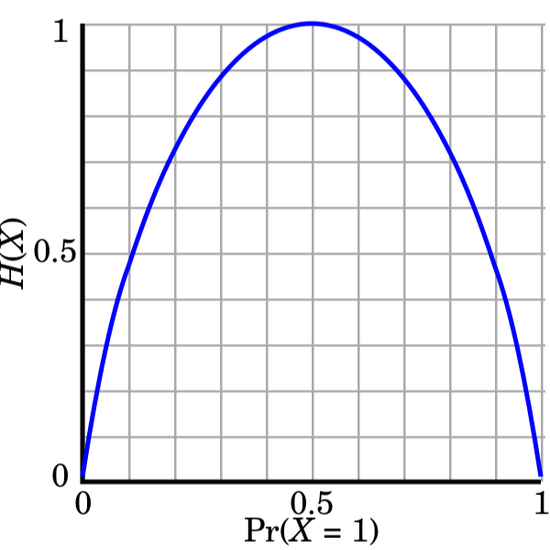
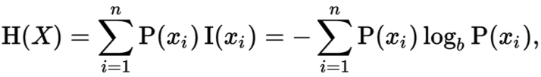
P=Q: Entropy
Abstract idea of “information” - usually measured in bits
Similar to digital bits: one bit = {0,1}, two bits = {0,1,2,3}, etc.
Entropy: information needed to specify a random variable
In expectation: can be fractional
H(p) = - sum p log(p) =
Notes:
How is this useful in an operational sense?
Say:
P(x0) = 0.01 → I(x0) = log2(1/0.01) = 6.66
P(x1)=0.99 → I(x1) = log2(1/0.99) = 0.014
Sure, if we’re transmitting 0.014 bits 99% of the time, that’s a pretty low entropy (almost 0 bits required.) However in reality we’re constrained to only transmit integer bits. (See next slide.)

Slide 50
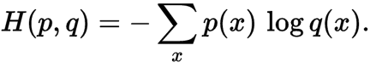
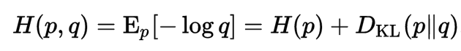
Cross-Entropy
Cross-entropy: measure of information encoding cost across distributions
P(x) = “true” distribution
Q(x) = predicted/estimated distribution
Given optimal encoding for Q, how many bits to encode p ~ P?

Slide 51
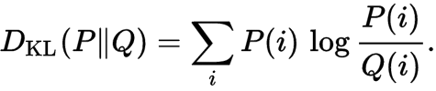

Slide 52
Minimizing Cross-Entropy: Most-Common in NLP
Cross entropy is the general concept for probability distributions with multiple classes
Applied to logistic regression reduces into familiar loss
p(x) = real distribution, usually 1-hot
q(x) = model estimated distribution
Since p(x) is (very) sharp, you get no loss if q(x) matches it exactly.

Slide 53
KL Divergence
KL-divergence explained
KL Divergence: measure of "distance*" between two distributions
P(x) = “true” distribution
Q(x) = predicted/estimated distribution
Given Q, how many bits (on average) to specify P?
* KL Divergence is not an actual distance metric (not symmetric).
Notes:
Is it fair to say KL Divergence is the difference between the optimal average number of bits and the operational number of bits as a result of our assumed distribution Q?
Maybe the question above could be: “Given Q, how many more bits on average to represent data with true distribution, P?”

Slide 54
Next Week!
Finalizing Feed-Forward Neural Networks
Neural Net Training
Initialization

Slide 55
Appendix/Extras

Slide 56
What if your probability distribution is wrong?
p = real; q = original guess
Expected encoding length = -∑p(x) lg q(x)
= -∑p(x) lg p(x) + [∑p(x) lg p(x) - ∑ p(x) lg q(x)]
= - ∑ p(x) lg p(x) + ∑ p(x) lg (p(x)/q(x))
= [Optimal encoding for p, had we known] + [extra because we were wrong]
= entropy(p) + KL Divergence (P || Q)

Slide 57
Information Entropy
Intuition:
Really high entropy?
Really low entropy?
What about 0 entropy?

Slide 58
What if your probability distribution is wrong (2)?
p = real; q = original guess
Expected encoding length = -∑p(x) lg q(x)
= -∑p(x) lg p(x) + [∑p(x) lg p(x) - ∑ p(x) lg q(x)]
= - ∑ p(x) lg p(x) + ∑ p(x) lg (p(x)/q(x))
= [Optimal encoding for p, had we known] + [extra because we were wrong]
= entropy(p) + KL Divergence (P || Q)

Slide 59
What if your probability distribution is wrong?
I give you a distribution of symbols
You assign them encodings
It turns out that my distribution is wrong!
We start sending symbols with your encoding.
What happens?
Notes:
Maybe the “probability density is wrong” applies to our physical constraint of only transmitting integral numbers of bits for characters where our true distribution would have us dealing in fractional bits to get ideal entropy.
So perhaps “wrong distribution” occurs by necessity all the time, not simply because we made a faulty attempt at a coding scheme…?

Slide 60
Task -> (recast) problem structure
Some advances in NLP are made by re-casting a task with a new structure:
Grammar as a foreign language - recast constituency parsing as sequence to sequence emitting flattened parse tree symbols
NLP Decathlon - recast all tasks as question answering
Unified Text to Text transformer (T5) - recast all tasks as a sequence to sequence text generation

Slide 61
Exercise
A language has two symbols:
“A” with probability 0.5
“B” with probability 0.5
How would you encode them in binary?

Slide 62
Exercise
A language has two symbols:
“A” with probability 0.5
“B” with probability 0.5
How would you encode them in binary?
A-> 0; B-> 1

Slide 63
Exercise
“A” with probability 0.5 (0)
“B” with probability 0.5 (1)
Expected length per symbol?

Slide 64
Exercise
“A” with probability 0.5 (0)
“B” with probability 0.5 (1)
Expected encoding length per symbol?
E[symbol_encoding_length] = ∑ p(symbol) * symbol_length
= 0.5 * 1 + 0.5 * 1 = 1
= ∑ p(symbol) * (-lg(p(symbol)))

Slide 65
Exercise
A language has three symbols:
“A” with probability 0.5
“B” with probability 0.25
“C” with probability 0.25
How would you encode them in binary?

Slide 66
Exercise
Observations...
Encode the symbols that happen often with really short bit strings
Notice that the # of bits you need for these symbols is -lg(p(symbol))
A language has three symbols:
“A” with probability 0.5
“B” with probability 0.25
“C” with probability 0.25
How would you encode them in binary?

Slide 67
Exercise
“A” with probability 0.5 (0)
“B” with probability 0.25 (10)
“C” with probability 0.25 (11)
E[symbol_length] = ∑ p(symbol_i) * symbol_length_i
= ∑ p(symbol_i) * -lg(p(symbol_i)) = 0.5 * 1 + 0.25 * 2 + 0.25 * 2 = 1.5.

Slide 68
What if your probability distribution is wrong?
I give you a distribution of symbols (q(symbol))
You assign them encodings
It turns out that my distribution is wrong! (really p(symbol))
We start sending symbols with your encoding.
What happens?
Expected encoding length = ∑p(x) * length of x = -∑p(x) lg q(x)

Slide 69
Cross-Entropy & Average Length per Symbol
In our symbol transmission example, imagine a true and unknown probability distribution P(x) over symbols (‘words’). And, say, P(x) may depend on the previously sent symbols in unknown ways (think: translation), etc.. I.e. HARD to ‘just measure and use’.
A test-person assumes a(nother) history-dependent distribution Q(x) and uses the appropriate Huffman encoding (L ~ - log(Q(x))
How can this test person optimize her/his Q(x)?
Find the length of the overall messages in the training set
Then recalculate length for a slightly modified Q(x) with it’s Huffman encoding. Is it shorter? Then this is a better Q(x). Change Q more in this ‘direction’, etc.
This is exactly minimizing the cross-entropy CE = - ∑_{x} P(x) log Q(x) [summing over all positions over all symbols]

Slide 70
Cross-Entropy & Average Length per Symbol
How short can the average length per symbol get?
S = - ∑_{x} P(x) log P(x) is minimum length. This is the entropy.
What is the Kullback-Leibler Divergence?
D_{KL} = CE - S . Simply subtract S from CE
Why do that?
Min(D_{KL}) = 0. Kind of nice.
But minimizing D_{KL} is the same as minimizing CE… [f(x) = x² -2 x - 5 minimizes at the same x as g(x) = x² - 2x ]

Slide 71
Some Easy Questions
Assume:
Fully connected layer with an input batch of examples coming in to a neural net. Batch size is 8, and each example has 12 features
The first hidden layer has dimension 10
The equation for the output of the hidden layer is given by:
y = σ(x W + b)
Questions: What are the dimension of
x?
W?
b?
Please put the answers in the chat… 60 s

